Slide 1
The New York School BUS Project
[GIC_OND21_PYSPARK]
(Alankrita Panday,
Sunidhi Soni,
Varsha Singh Chauhan)

Slide 2
Project Description
Problem statement
Data flow
Fields name of data
Use cases
Why pyspark
Features of pyspark
Use_cases solution

Slide 3
Problem Statement
The New York School authority collects data from all schools that provide bus facilities to students. This data helps to understand if buses are reaching on time or not. This also helps to understand if there is a specific route where buses are taking more time so that it can be improved. we have a dataset of buses which got broke down or are running late.
Data Source :- WWW.Kaggle.com
Total number od data 277113

Slide 4
Data Flow
Kaggle.com
(Data source)
Create Spark DF by reading source
Run Script file by Pyspark < filename
Load CSV data in windows CMD
Data Analysis

Slide 5
Fields Name of Project
1. School_Year
2. Run_Type
3. Bus_No 4. Route_Number 5. Reason 6. Occurred_On 7. Number_Of_Students_On_The_Bus

Slide 6
Use_Cases
1.Load data and create Spark data frame
2.Most common reasons for either a delay or breaking down of the bus 3. Top five route numbers where the bus was either delayed or broke down 4. The total number of incidents, year-wise, when the students were Not on the bus 5. The year in which accidents were less
6.how many incidents are done in 2015-2016 and 2017-2018
7. Year _wise number of incident

Slide 7
Why Pyspark
PySpark is an interface for Apache Spark in Python. It not only allows you to write Spark applications using Python APIs, but also provides the PySpark shell for interactively analyzing your data in a distributed environment.
Spark has been found to run 100 times faster in-memory, and 10 times faster on disk. It's also been used to sort 100 TB of data 3 times faster than Hadoop MapReduce on one-tenth of the machines. Spark reduces the number of read/write cycles to disk and store intermediate data in-memory, hence faster-processing speed. It Spark reduces the number of read/write cycles to disk and store intermediate data in-memory, hence faster-processing speed.

Slide 8
Features of Pyspark
Fault tolerance
Real time processing
Reusability
Speed
In memory

Slide 9
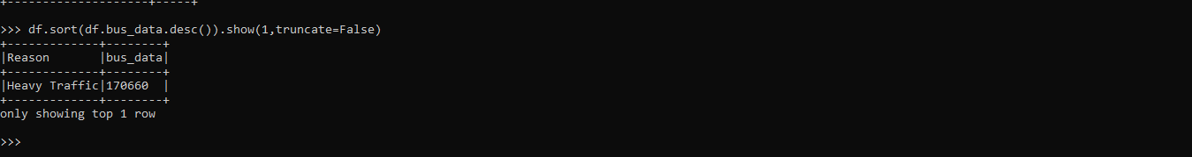
Use_cases Solution 1. Most common reasons for either a delay or breaking down of the bus
Import packages
SparkContext SQLContext
Function

Slide 10
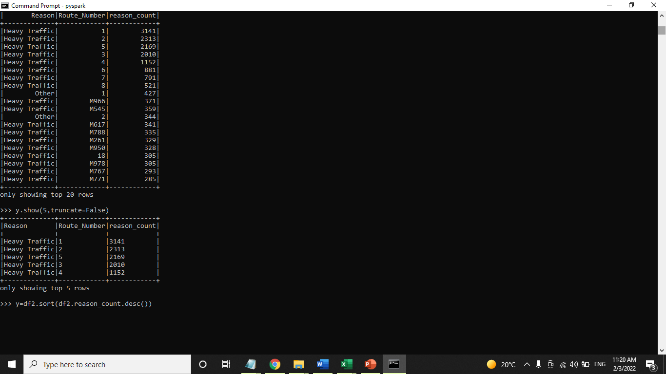
2. Top five route numbers where the bus was either delayed or broke down

Slide 11
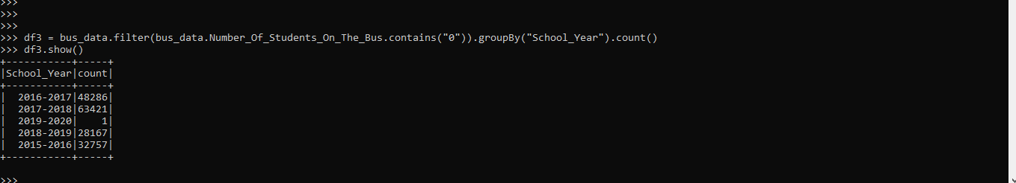
3. The total number of incidents, year-wise, when the students were Not on the bus

Slide 12
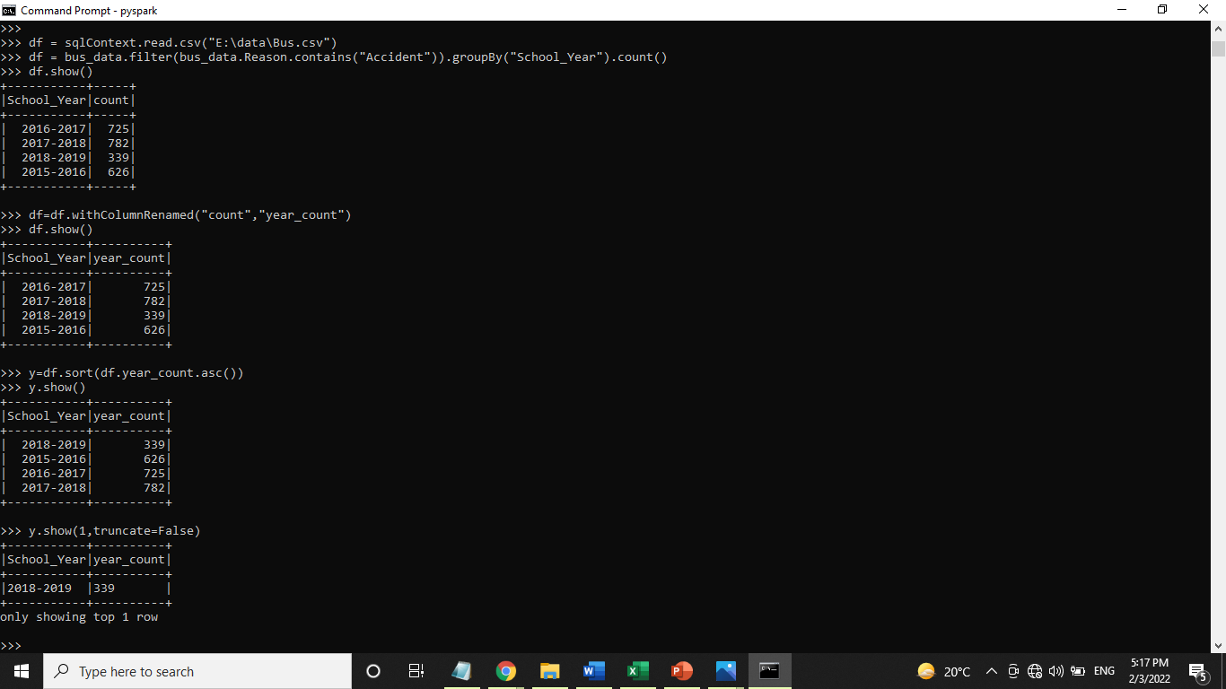
4. The year in which accidents were less

Slide 13
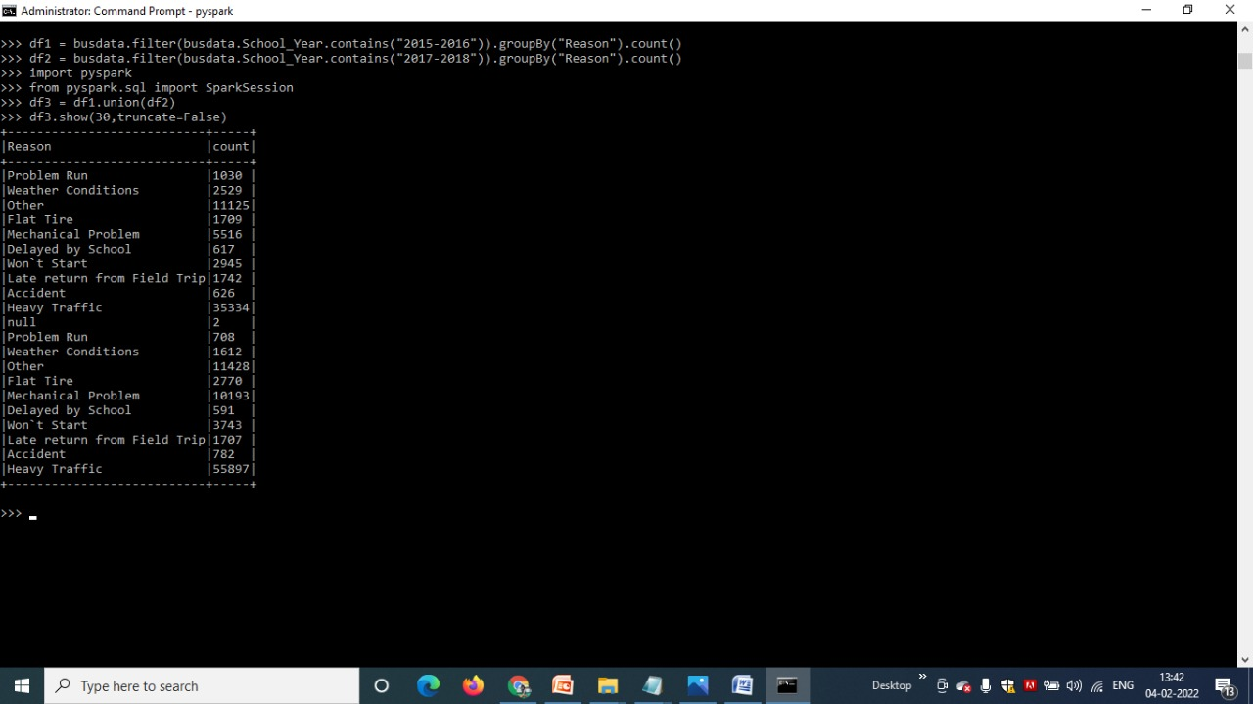
5. how many incidents are done in 2015-2016 and 2017-2018

Slide 14
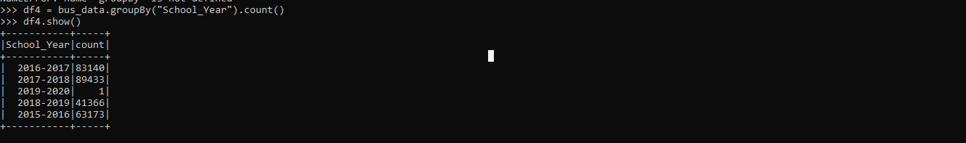
6. Year _wise number of incident

